Slide 1
Digitalisation of the client acquisation process at the Swiss Construction Association Pension Fund
Team «Gestellter»
Jason Amstutz, Manuela Kaufmann, Yesim Ruf
Notes:
Welcome to our presentation about the digitalization of the client acquisition process at the Swiss construction associations pension fund.

Slide 2
Agenda
Project sponsor
As-Is Process
To-Be Process
Demonstration
Questions

Slide 3
Project sponsor - Swiss Construction Association Pension Fund
Small pension fund specialized on the construction industry
Pension plans tailored to the needs of the construction industry
Facts & Figures
All figures refer to the business year 2020
Number of affiliated companies:
Persons insured:
Number of pension fund employees:
276
3’390
5
Notes:
Before we get to the interesting part (the to-be process), we want to give you some background information about the pension fund and the as-is process.
The Swiss constructions association pension fund is a small pension fund which is specialized on the construction industry.
We have 9 pension plans which are tailored to the needs of the construction industry. The pension fund has 5 employees (including the manager and myself).
Since the new manger took over the pension fund in 2019, we are constantly working on the improve the client experience and service.

Slide 4
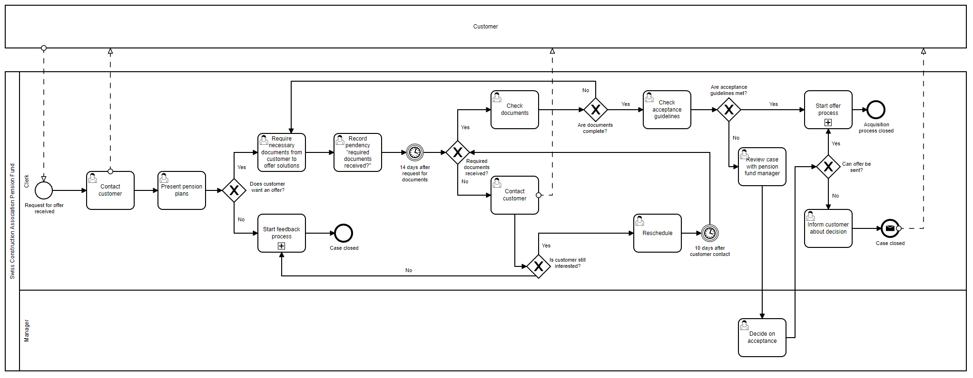
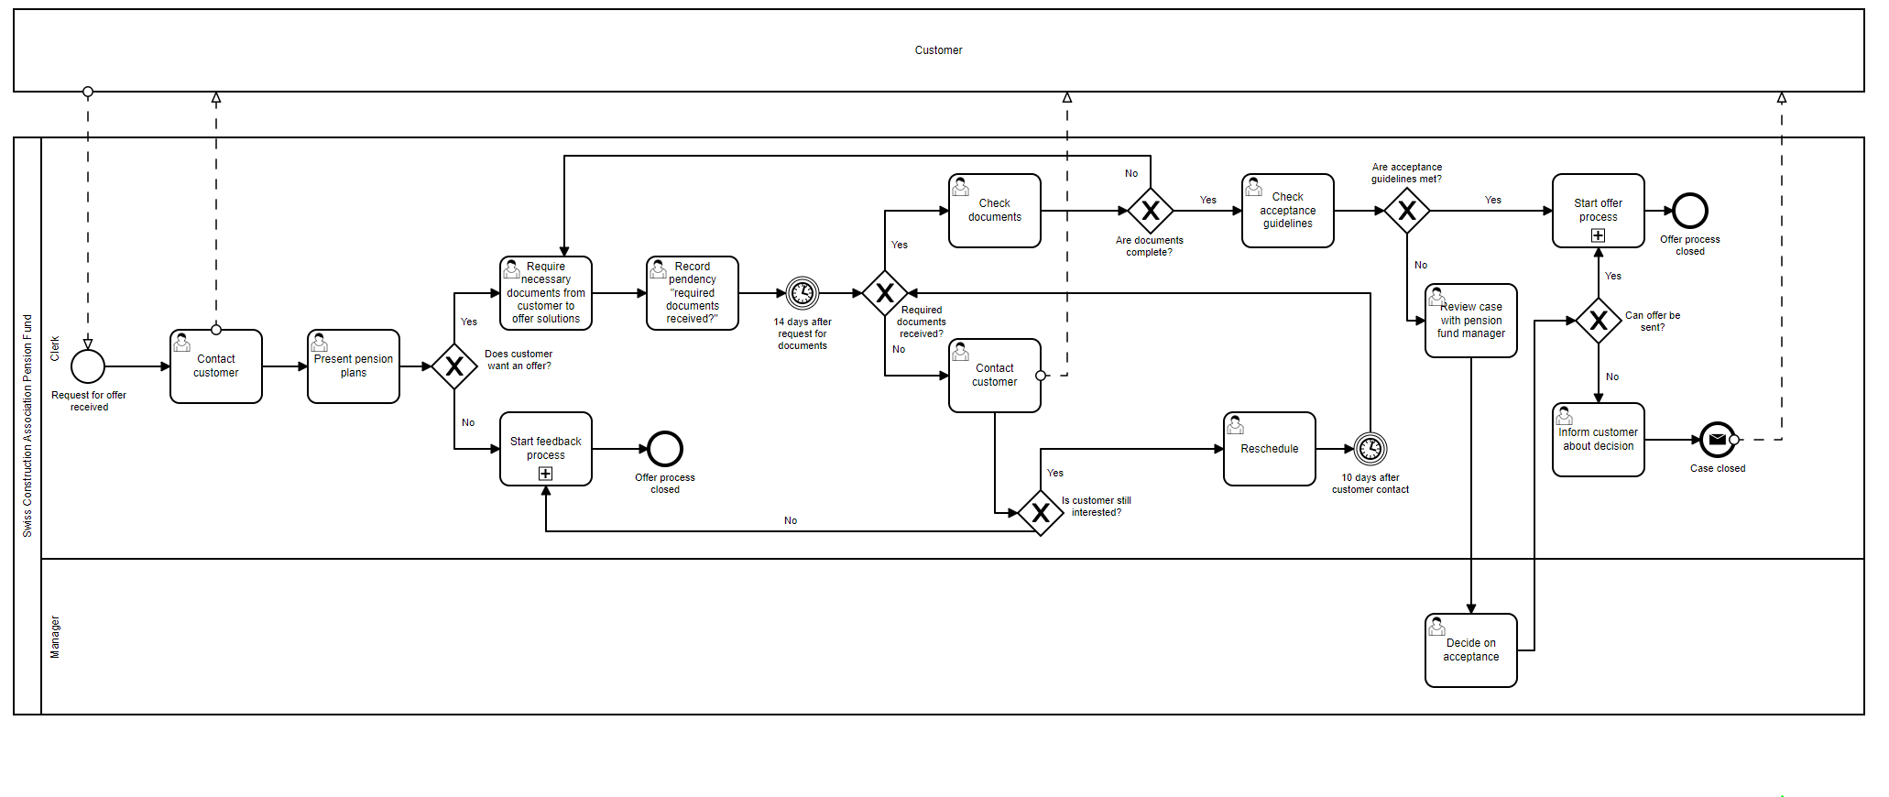
As-Is Process
Only «User Tasks»
High error potential
Potential for automatization
Contact by potential new clients per Email or phone
Customer can reach pension fund and get needed information only during the limited opening hours
Long lead times
Improving customer experience and service through the implementation of a chatbot
Notes:
The as is process of the client acquisition is mainly made up of user tasks and therefore has a high error potential.
The lead times till an offer can be send are long because the customer first needs to hand in information from his prior pension fund in order to know if he will be accepted in our pension fund and for the offer creation.
We have changed this approach in our to be process.
Also there is no active client acquisition in the as is process.
All the mentioned aspects show there is a potential for automatization of the workflow.

Slide 5
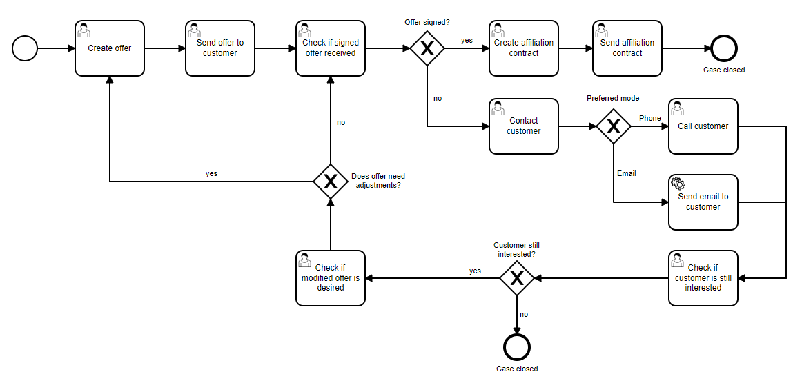
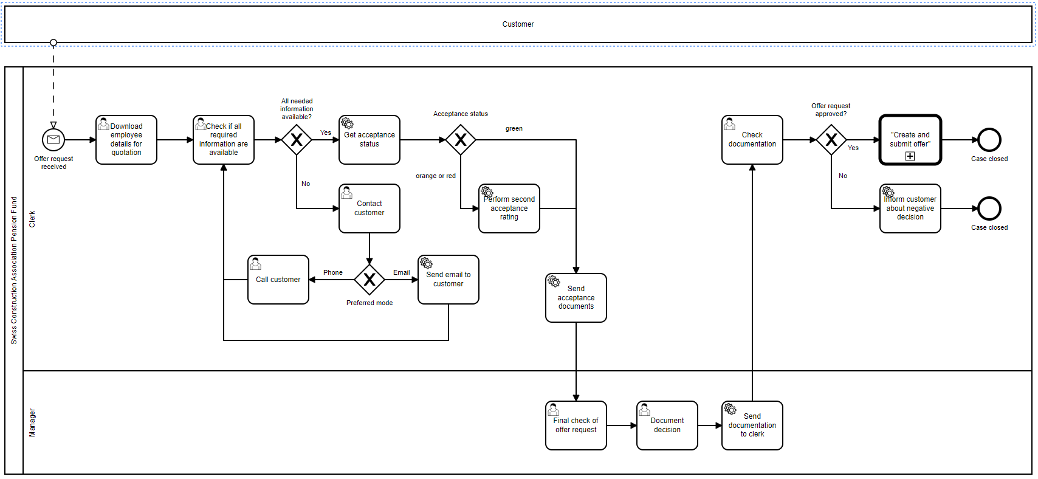
To-Be Process
Sub - Process
Notes:
As you see the to-be process and the sub – process contain 8 services tasks for which we created 8 make scenarios.

Slide 6
To-Be Process
Through the transformation of the process
A certain degree of automation could be achieved
Customer experience and service have been improved
Lead times are shortened, and the risk of errors is reduced
The potential for new customer acquisition is increased
Notes:
To sum up trough the transformation of the process we were able to
Achieve a certain degree of automation
We improced the customer experience and customer service
Shortend the lead times and reduced the risk of errors
The potential for new customer acquisition is increased
Now we will demonstrate the new client acquisition process to you.
https://sites.google.com/view/pk-sbv/startseite

Slide 7
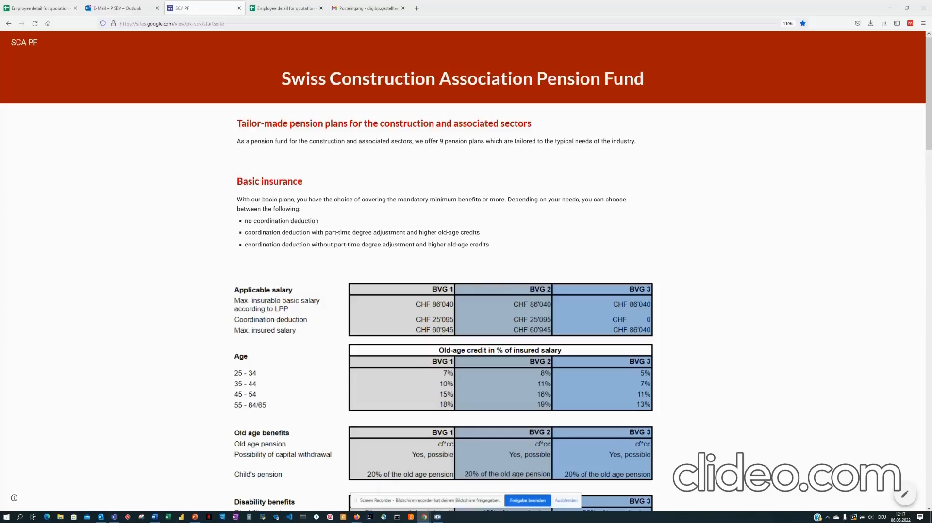
To-Be Process - Demonstration

Slide 8

Questions?

